Slide 1


Object Classification
Presented By-
👩‍🎓 Name: Meena E
🎓 Roll Number: 2023510036
📘 Program: B.Tech Artificial Intelligence & Data Science
🏫 Department: Information Technology
🏛️ Institution: MIT Campus, Anna University

Slide 2



Object Classification in Computer Vision: An Overview
Object classification is the process of identifying and categorizing objects within images and videos. It is one of the most fundamental and widely researched tasks in the field of computer vision. Accurate object classification powers numerous cutting-edge applications such as image recognition systems, autonomous vehicles, and security monitoring. Over time, methods have evolved from traditional machine learning techniques that rely on handcrafted features to modern deep learning algorithms that automatically learn from vast amounts of data.
Notes:
1

Slide 3
What is Object Classification?
Object classification involves assigning a label or category to an object present in one or more images. The input to the system is an image containing objects of interest, and the output is a predicted class label that identifies the object, coupled with a confidence score indicating the certainty of the prediction.
Example:
An image containing a cat is analyzed, and the system predicts the label "cat" with 95% confidence, indicating a high likelihood the prediction is correct.
Notes:
2

Slide 4

Human vs. Computer Vision
Human Vision
Computer Vision
Humans perceive the world intuitively with rich contextual understanding, easily recognizing objects across different angles, lighting, and partial occlusions.
Computer vision systems rely on explicit algorithms and extensive training data to identify objects, struggling with challenges like viewpoint variation, illumination changes, and deformation.
Comparison
Humans excel in ambiguous or novel situations, while computers shine at processing large datasets quickly and consistently with high accuracy when properly trained.
Notes:
3

Slide 5
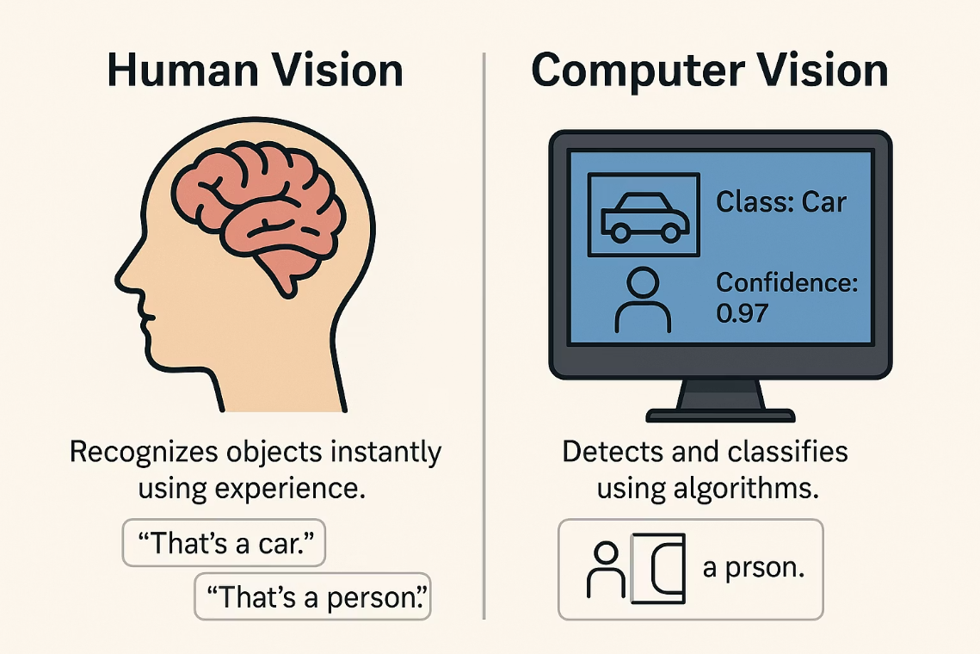
Notes:
4

Slide 6
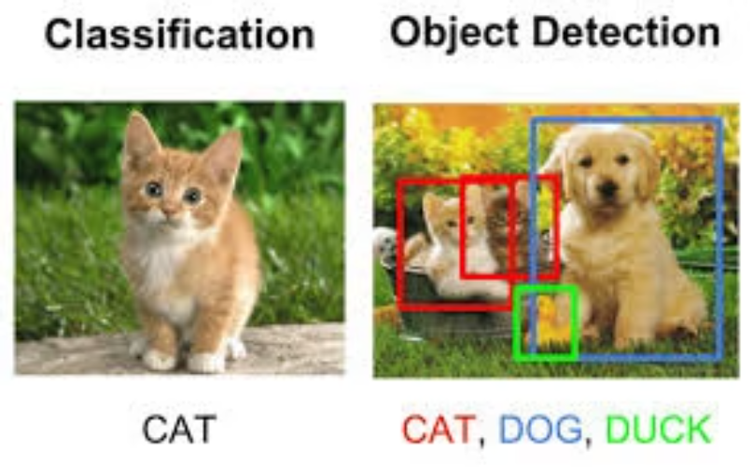
Object Classification vs. Object Detection
Object Classification labels the main object within an image.
Object Detection locates and identifies multiple objects with bounding boxes.
Classification answers "What is in the image?"
Detection answers "Where and what are objects in the image?"
Detection adds spatial context, making it essential for real-world applications.
Notes:
5

Slide 7
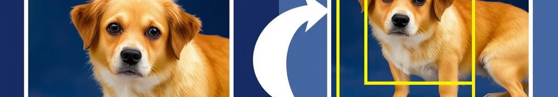


Image Classification vs Object Classification
Image Classification
Object Classification
Image Classification assigns a single label to an entire image.
Object Classification identifies and labels individual objects within an image.
Image classification is simpler but less detailed.
Object classification provides deeper insights for complex scenes.
Notes:
6

Slide 8





How Object Classification Works: A Step-by-Step Guide
Data Acquisition
Collect a diverse set of images and annotate them with accurate labels to train the model effectively.
Feature Extraction
Identify relevant characteristics or patterns in images that help distinguish different object classes.
Model Training
Use labeled data to teach the model to recognize patterns associated with each object category.
Prediction & Evaluation
Classify new images and evaluate the model’s performance using metrics like accuracy and recall to optimize results.
Notes:
7

Slide 9
Traditional Algorithms (ML-Based)
Traditional machine learning methods such as Support Vector Machines (SVM) and Random Forests rely on handcrafted feature descriptors like Histogram of Oriented Gradients (HOG) or Scale-Invariant Feature Transform (SIFT) to characterize objects in images.
Example:
An SVM using HOG features can classify cars versus pedestrians with about 75% accuracy, demonstrating decent effectiveness but noticeable limitations in handling diverse appearances and backgrounds.
These descriptors capture gradients or key points but often struggle to generalize in complex or highly variable environments.
Notes:
8

Slide 10

Support Vector Machine (SVM) Algorithm
1
Support Vector Machine is a powerful ML algorithm used for binary classification.
2
It finds the best boundary to separate classes by maximizing the margin between data points.
3
SVM uses kernel functions to handle non-linear data by mapping it to higher dimensions.
Sample Output: Given images of cats and dogs, SVM classifies each image correctly with a margin.
Notes:
9

Slide 11

Deep Learning Algorithms for Object Classification
Deep learning uses neural networks to automatically learn features from images.
Convolutional Neural Networks (CNNs) are the most common DL models.
CNNs learn hierarchical features, from edges to complex shapes, enhancing accuracy.
Other models include Recurrent Neural Networks (RNNs) for sequence data and Transformers for attention-based learning.
These algorithms vastly outperform traditional methods, especially in complex visual tasks.
Notes:
10

Slide 12

Convolutional Neural Network (CNN) Algorithm
Deep Learning Revolution in Object Classification
CNNs automatically learn features from raw images through layers of convolution and pooling.
They excel in identifying complex patterns across different scales and orientations.
Sample Output: ResNet-50 classifies images with over 90% accuracy on ImageNet dataset.
Notes:
11

Slide 13



Deep Learning vs. Traditional Machine Learning in Object Classification
Traditional Machine Learning (ML)
Deep Learning (DL)
Relies on handcrafted features like HOG or SIFT descriptors.
Automatically learns hierarchical features from raw images.
Algorithms such as SVM and Random Forest classify objects based on these features.
Uses models like Convolutional Neural Networks for end-to-end learning.
Requires extensive feature engineering
No manual feature crafting needed
Limited generalization in complex scenes
Better performance in challenging environments
Moderate accuracy (around 75%)
High accuracy, often exceeding 90%
Notes:
12

Slide 14
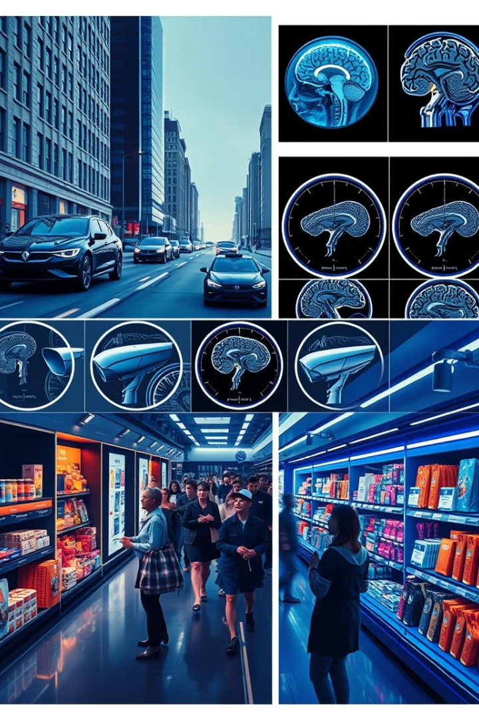
Applications of Object Classification
Autonomous Vehicles
Detect pedestrians, traffic signs, and obstacles, enabling safe navigation and real-time decision-making.
Medical Imaging
Support disease diagnosis and anomaly detection, such as identifying cancerous regions in radiology images.
Security
Enhance surveillance and facial recognition systems for improved safety and access control.
Retail
Automate product recognition and checkout processes to streamline operations and improve customer experience.
Notes:
13

Slide 15
Conclusion and Key Takeaways
Object classification remains a cornerstone of computer vision with transformative impacts across numerous sectors. The transition from traditional machine learning to deep learning algorithms has led to significant performance gains, enabling more accurate and resilient recognition capabilities.
Looking ahead, ongoing research is focused on improving efficiency, handling more complex scenarios, and integrating object classification into broader AI systems, promising exciting advances in automated perception and intelligent decision making.
Notes:
14

Slide 16


